Slide 1
Program comprehension/understanding
Brent Staab – P1
CS 515-801
Spring 2020

Slide 2
Outline
What is program comprehension
Why is it hard
Tools to comprehend

Slide 3
What is program comprehension
Program comprehension is a domain of Computer Science concerned with the understanding of an existing software system.
It involves the cognitive process of developing mental models of a software systems intended architecture, meaning, and behavior. Examples include
Structure: What components are used and what are their interrelationships
Functionality: What operations are performed on what components
Dynamic/Runtime behavior: How input is transformed to output
Rationale: Why were certain decision made
Construction: Source code, documentation, and test suites
Program Comprehension does NOT change the subject system, nor create a new system.
Program comprehension is also known as “program understanding” or “source code comprehension”

Slide 4
Why is it important
You need to be able to read a function and know what it will do with its inputs; you need to be able to read a class and understand its state and functionality; you also need to be able to comprehend a whole implementation, understanding its architecture. Without these skills, you can't test well, you can't debug well, and you can't fix or enhance the systems you're building or maintaining [7]
Foundational piece needed to effectively complete the other tasks associated with MESS

Slide 5
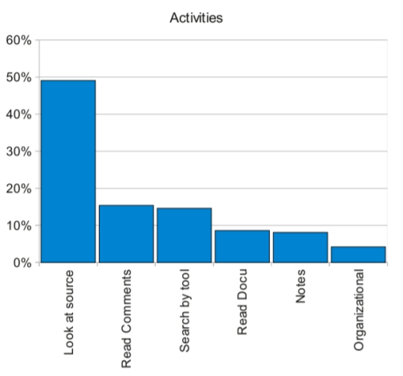
Effort
Developers spend most of their time with understanding source code [4]
Studies of software engineers' first year at their first job show that a significant majority of their time is spent trying to simply comprehend the architecture of the system they are building or maintaining and understanding the processes that are being followed to modify and enhance them [7]

Slide 6
History
Subtitle goes here

Slide 7
Why is it hard
The problem has evolved over time
Language
Machines communicate in a different language than people
Machines communicate in binary (1’s and 0’s)
People communicate in natural languages (like English, Spanish, etc)
Size of project
Number of files
Number of developers contributing
Complexity

Slide 8
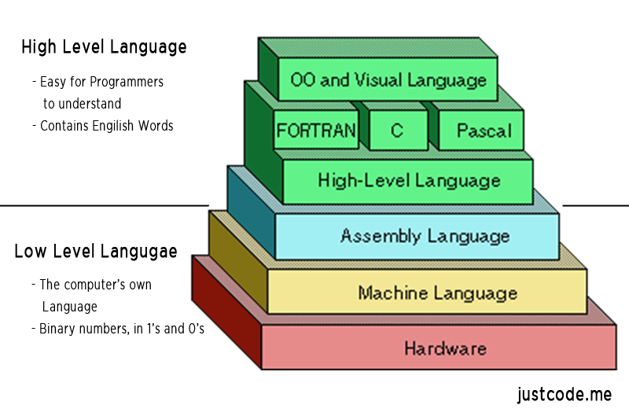
Programming languages
Low level languages are used to write programs that relate to the specific architecture and hardware of a particular type of computer
HLL - High level languages are written in a form that is close to our human language

Slide 9
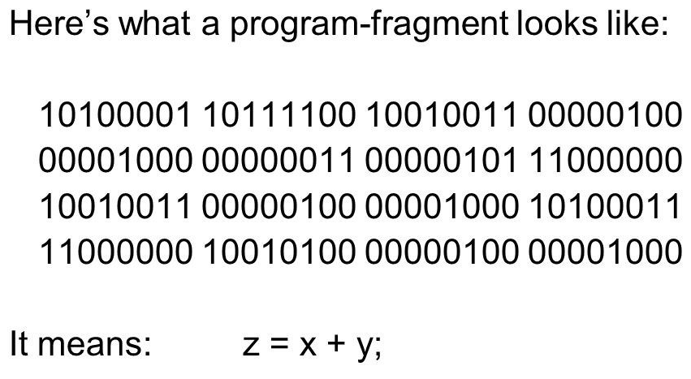
Machine Language
Restricted to numerical values
Advantages
Does not require a translator
Directly understood by the computer
Little abstraction, statements directly to clock cycles
Disadvantages
Machine-dependent
Non-portable
Tough to understand, maintain and debug

Slide 10
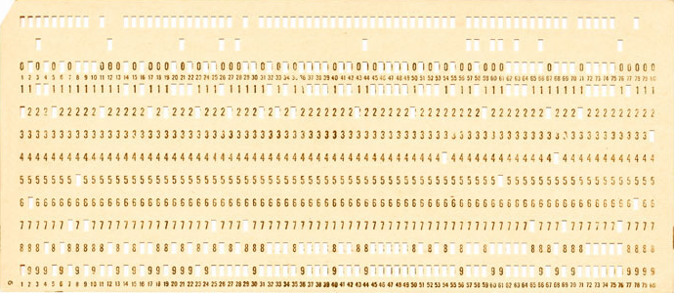
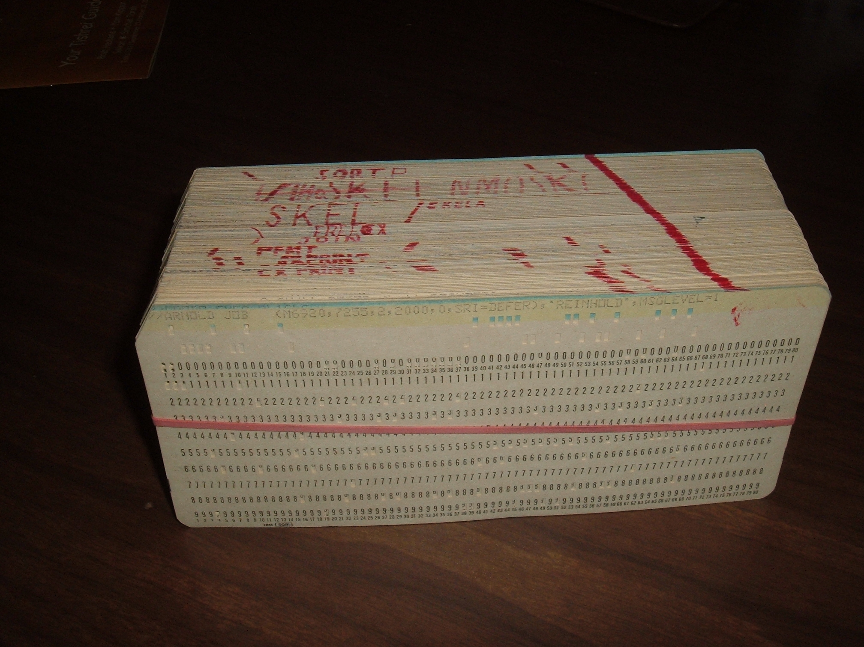
Punch Cards
Punch cards are generally a stiff piece paper where holes punched in predefined locations represent computer data and instructions [1].
One or more cards, in a specific sequence, represent a program or a task to be accomplished.
The cards are fed into the machine via a dedicated reader which converts the pattern of holes into a digital representation.

Slide 11
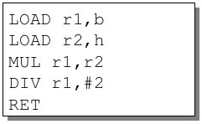
Assembly language
An assembly language is a low-level programming language designed for a specific family of processor. It represents various instructions in symbolic code which is more understandable to humans[3].
While assembly languages differ between processor architectures, they often include similar instructions and operators. Below are some examples of instructions supported by x86 processors.
MOV - move data from one location to another
ADD - add two values
SUB - subtract a value from another value
PUSH - push data onto a stack
POP - pop data from a stack
JMP - jump to another location
INT - interrupt a process
BSTAAB – Need to rewrite in my own words

Slide 12
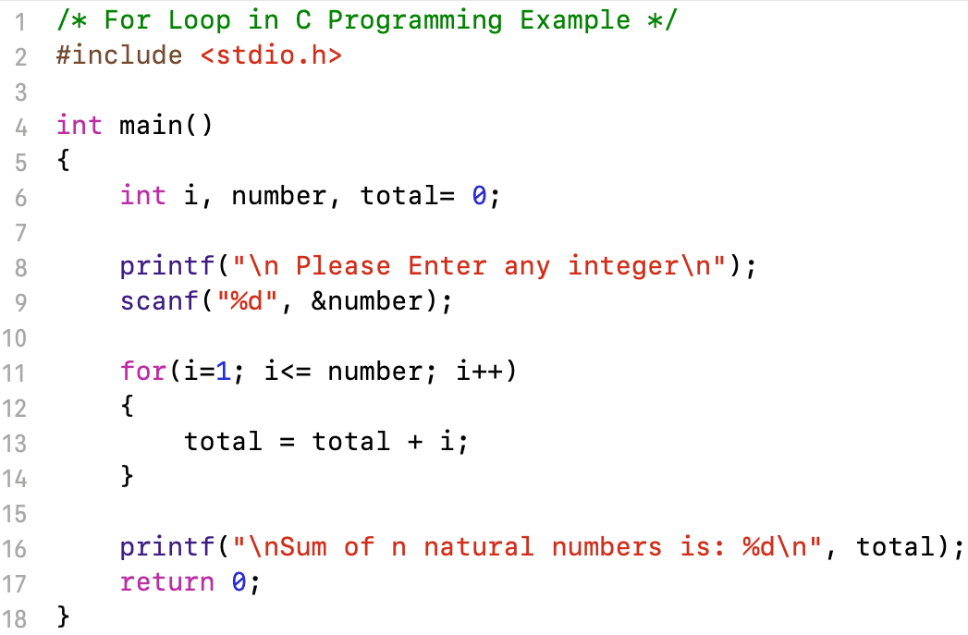
High-level languages (HLL)
Advantages
Programmer friendly language.
Easier to understand, debug and maintain
Not machine dependent,
Is portable.
Disadvantages
Not optimized for a specific machine
Generally slower than LLL
It needs compiler or interpreter for translation.

Slide 13
Style Guide
A style guide is set of rules or conventions used when writing source code for a computer program.
The objective of a style guide is to have code created by a group or company look like it was written by a single person, regardless of the number of contributors.
Having common conventions makes the code uniform and easier to understand.
Items commonly seen in a style guide
Indention
White space around operators
Variable naming
Vertical alignment
Comments
File/folder naming & hierarchy
Etc.

Slide 14
Format - Indention
Indention
Used to convey structure or the link between flow control
Tabs vs Spaces, pick one
Miara and others evaluated how different indentation spaces (0, 2, 4, or 6 white spaces) affect comprehensibility. They found that indentation of 2 to 4 white spaces was most beneficial for program comprehension.
Case
Defines how variables with compound names are represented
There are a variety of styles to choose from
camelCase: First letter is lowercase, then the first letter of every new word is capitalized and is compounded with the previous word.
UpperCamelCase (a.k.a. PascalCase): Every word starts with an uppercase letter
kebab-case: Replace all spaces with a "-" and lowercasing all the words.
snake_case: Replace all spaces with a "_" and lowercasing all the words.
UPPER_CASE_SNAKE_CASE: Replace all the spaces with a "_" and converting all the letters to capitals.
Sharif and Maletic evaluated the effect of under_score vs. camelCase style on recognition time [27]. As result, they found that identifiersin under_score style are recognized faster than identifiers in camelCase.
Color-coding
Coloring different kinds of statements to represent structure or functionality
He found that coloring different kinds of statements lead to better comprehensibility than coloring control structures (which in turn was better than no color coding).

Slide 15
Integrated Development Environments (IDE)
In the early days, source code was often written with a standard editor, such as Emacs or vi. However, as the complexity of programs grew, a standard text editor was not sufficient anymore, so the need for integrated development environments rose quickly [4]
White Space
Miara and others evaluated how different indentation spaces (0, 2, 4, or 6 white spaces) affect comprehensibility.
They found that indentation of 2 to 4 white spaces was most beneficial for program comprehension.
Color-coding
[15]. Rambally evaluated how different color-coding styles affect comprehensibility [22].
Specifically, he compared how color-coding control structures (e.g., scope of a loop) vs. different kinds of statements (e.g., I/O, variable declarations) affects comprehension.
He found that coloring different kinds of statements lead to better comprehensibility than coloring control structures (which in turn was better than no color coding).
We know that developers need IDE support and that code layout can significantly affect program comprehension

Slide 16
Visualization
Software visualization is the practice of creating visual tools to map software elements or otherwise display aspects of source code. This can be done with all kinds of programming languages in different ways with different criteria and tools.
The fundamental idea behind software visualization is that by creating visual interfaces, creators can help developers and others to understand code or to reverse-engineer applications. A lot of the power of software visualization has to do with understanding relationships between pieces of code, where specific visual tools, such as windows, will present this information in an accessible way
https://www.techopedia.com/definition/22851/software-visualization

Slide 17
Visualization
Static vs Dynamic
The static model represents the general relationship between several components of the software while the dynamic model shows the actual interplay between components during execution.
http://www.gkc.org.uk/msc-se-2017/01-program-comprehension.pdf
Static information is extracted directly from the source code. This information can be visualised by well known diagrams like call graph, flow chart, dependency graph, class diagram, etc

Slide 18
Static Visualization
Static information is extracted directly from the source code. This information can be visualized by well known diagrams like call graph, flow chart, dependency graph, class diagram, etc
A static model is any collection of information which can be discovered by examining the source code of the system and related documents.
Static models are usually valid for all possible executions of the program

Slide 19
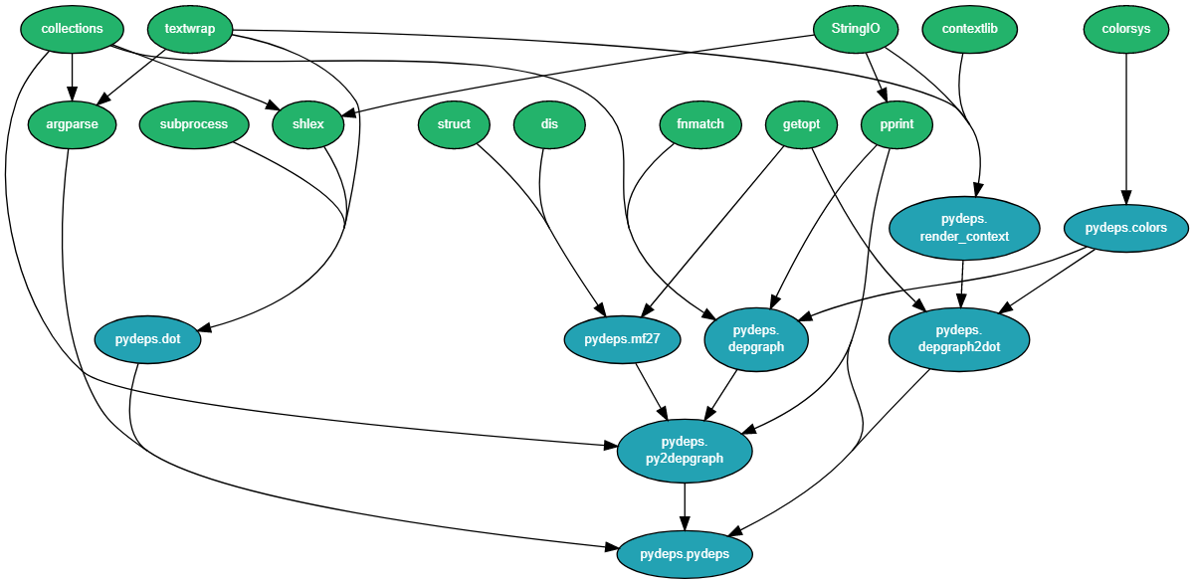
Static Visualization
Dependeycy graph
https://github.com/thebjorn/pydeps

Slide 20
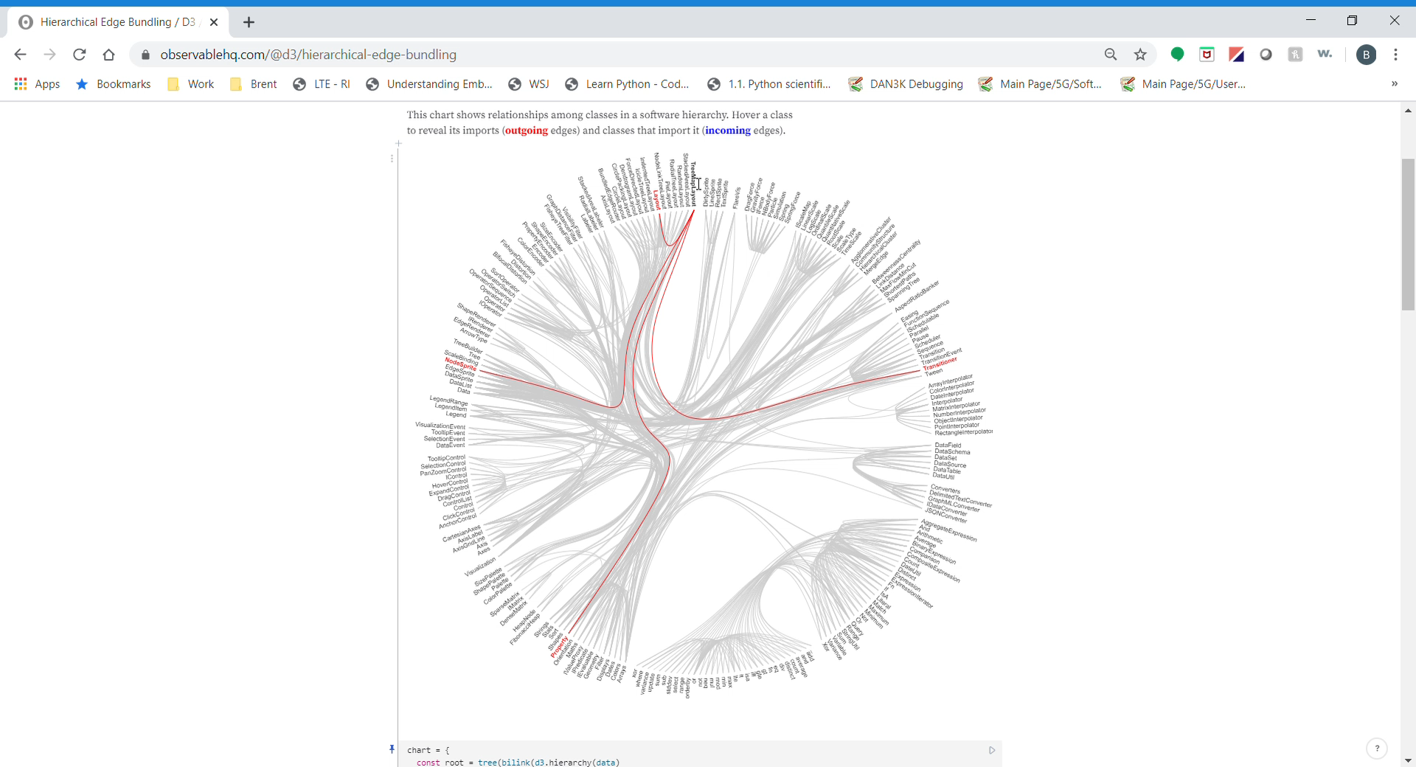
https://bl.ocks.org/mbostock/7607999

Slide 21
Dynamic Visualization
A dynamic model is any collection of information which can be discovered by executing the software and examining input data, output data, execution traces and any other data produced by the program execution
Dynamic models may only be valid for the particular input, or set of inputs, which were used to generate the data.

Slide 22
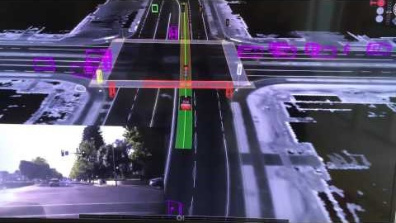
Visualization
https://www.theverge.com/2019/2/19/18229397/uber-gm-cruise-av-visualization-open-source

Slide 23
References
[1] https://www.computerhope.com/jargon/p/punccard.htm
[2] https://techterms.com/definition/assembly_language
[3] https://www.tutorialspoint.com/assembly_programming/assembly_introduction.htm
[4] 2016 IEEE 23rd International Conference on Software Analysis, Evolution, and Reengineering
[5] https://www.chaseadams.io/most-common-programming-case-types/
[6] https://www.pullrequest.com/blog/create-a-programming-style-guide/
[7] https://faculty.washington.edu/ajko/books/cooperative-software-development/comprehension.html

Slide 25
Integrated Development Environments (IDE)
Some text here
camelCase must (1) start with a lowercase letter and (2) the first letter of every new subsequent word has its first letter capitalized and is compounded with the previous word.
An example of camel case of the variable camel case var is camelCaseVar.
snake_case is as simple as replacing all spaces with a "_" and lowercasing all the words. It's possible to snake_case and mix camelCase and PascalCase but imo, that ultimately defeats the purpose.
An example of snake case of the variable snake case var is snake_case_var.
kebab-case is as simple as replacing all spaces with a "-" and lowercasing all the words. It's possible to kebab-case and mix camelCase and PascalCase but that ultimately defeats the purpose.
An example of kebab case of the variable kebab case var is kebab-case-var.
PascalCase (a.k.a. UpperCamelCase) has every word starts with an uppercase letter (unlike camelCase in that the first word starts with a lowercase letter).
An example of pascal case of the variable pascal case var is PascalCaseVar.
Note: It's common to see this confused for camel case, but it's a separate case type altogether.
UPPER_CASE_SNAKE_CASE is replacing all the spaces with a "_" and converting all the letters to capitals.
an example of upper case snake case of the variable upper case snake case var is UPPER_CASE_SNAKE_CASE_VAR.

Slide 26
Program comprehension – What it is
The purpose of program comprehension is to understand an existing software system
Program comprehension ("program understanding," "source code comprehension") is a domain of computer science concerned with the ways software engineers maintain existing source code. The cognitive and other processes involved are identified and studied. The results are used to develop tools and training.
Program Comprehension is the process of developing mental models of a software systems intended architecture, meaning, and behavior
Program Comprehension aims to recover high-level information about a system including:
Its structure (components and their interrelationships)
Its functionality (what operations are performed on what components)
Its dynamic behavior (how input is transformed to output)
Its rationale (how was the design process and what decisions have been taken)
Its construction, modules, documentation, and test suites
Program Comprehension does not change the subject system, nor create a new system. It is the process of examining and understanding the object system.
Program comprehension is an important cognitive process in software development, because developers spend most of their time with understanding source code [4]

Slide 27
Program comprehension - objectives
Which type represents this domain concept or this UI element or action?
Where is there any code involved in the implementation of this behavior?
What are the parts of this type?
Where does this type fit in the type hierarchy?
Where is this field declared in the type hierarchy?
Where is this method called or type referenced?
Where are instances of this class created?
What data can we access from this object?
What are the arguments to this function?
What data is being modified in this code?
How are these types or objects related?
How does this data structure look at runtime?
How is control getting (from here to) here?
Which execution path is being taken in this case?
What parts of this data structure are accessed in this code?
What are the differences between these files or types?
Is there an entity named something like this in that unit (for example in a project, package or class)?
Which types is this type a part of?
Does this type have any siblings in the type hierarchy?
Who implements this interface or these abstract methods?
When during the execution is this method called?
Where is this variable or data structure being accessed?
What does the declaration or definition of this look like?
What are the values of these arguments at runtime?
How are instances of these types created and assembled?
How is this feature or concern (object ownership, UI control, etc) implemented?
What is the "correct" way to use or access this data structure?
What in this structure distinguishes these cases?
How can data be passed to (or accessed at) this point in the code?
What is the mapping between these UI types and these model types?
How can we know this object has been created and initialized correctly?
Why isn't control reaching this point in the code?
Under what circumstances is this method called or exception thrown?
How does the system behavior vary over these types or cases?
What is the difference between these similar parts of the code (e.g., between sets of methods)?
Where in the code is the text in this error message or UI element?
https://faculty.washington.edu/ajko/books/cooperative-software-development/comprehension.html

Slide 28
Programming languages
The first programmable computers were programmed with machine code, that is, sequences of 1’s and 0’s (the presence/
absence of holes in punched cards). Now imagine you were to give an instruction to your computer and had to work
only with 1’s and 0’s—it would be very difficult to memorize what the sequence 0000 0100 1100 1011 means
and not confuse it with other sequences. Thus, assembly languages have been developed, which allowed developers
to use mnemonics, so that developers could work with instructions, such as add $t1, $t2, $t3, instead of 0000
0100 1100 1011 [25]. However, this still required lowlevel programming close to the hardware, that is, moving
numbers around the registers of a CPU. Thus, higher-level programming languages were developed,
such as COBOL, Fortran, Java, or C#. These allow developers to more directly translate their programming problem to a
programming language. Thus, instead of directly working with CPU registers, developers can simply write if a = 1
then t1 = t2 + t3, which better reflects the intention of what programmers want to do. To ease programming, APIs have been developed, which allowed programmers to reuse often used features without having to implement them[4]

Slide 29
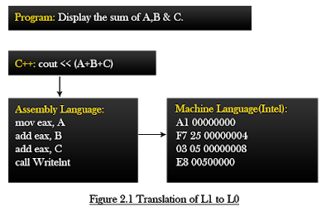
Low-level languages (LLL)
It is a machine friendly language
Low level language is high memory efficient
It is tough to understand.
It is complex to debug comparatively
It is complex to maintain comparatively
It is non-portable.
It is machine-dependent.
It needs assembler for translation.

Slide 30
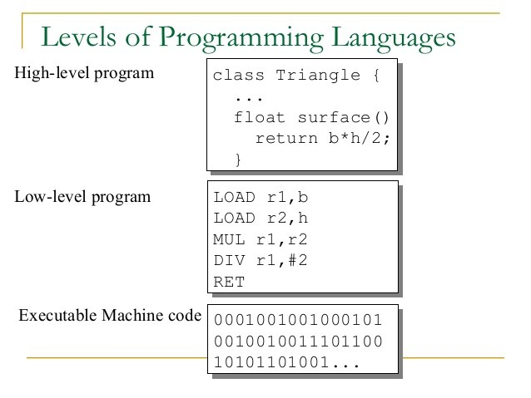
High-level languages (HLL)

